Slide 1
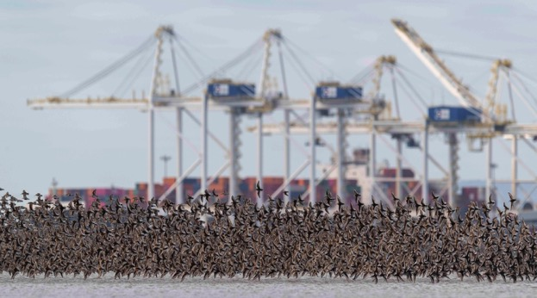
Fraser Estuary:
On the Brink of Collapse - Roberts Bank Terminal 2 may be the Tipping Point
By Roger Emsley
The Habitat, Ecology, Environment and Threats
© Jason Puddifoot
One of the most important ecosystems in Canada
© Jason Puddifoot

Slide 2
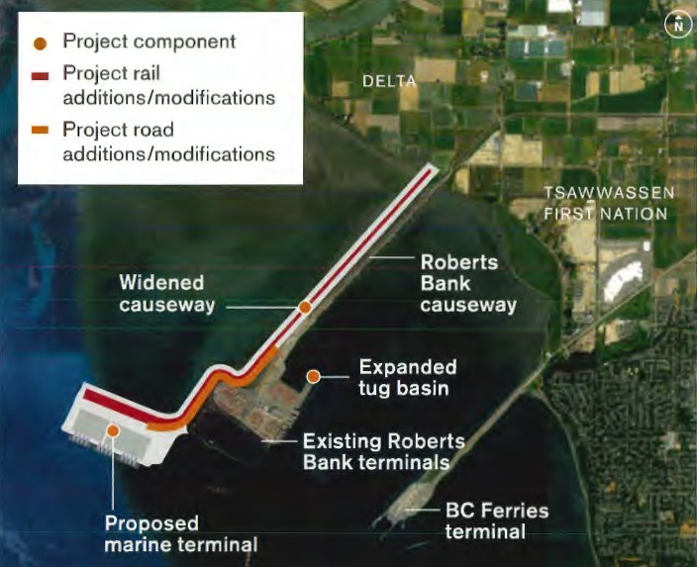
Roberts Bank Terminal 2 Project

Slide 3
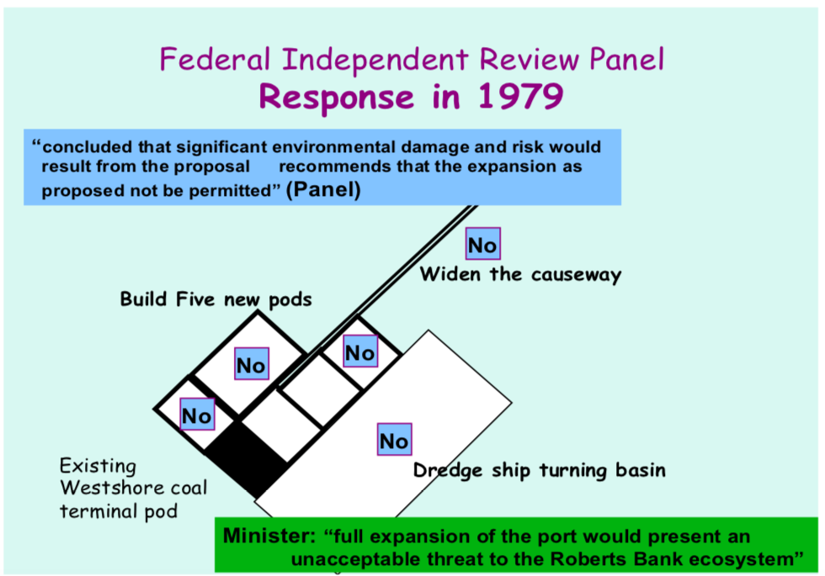
How did we get here?
© Mary Taitt

Slide 4
RB2 Project Timeline 2004 to March 16 2022
2004 Federal Environmental Assessment announced to include
Deltaport Third Berth plus Terminal 2.
2005 Port of Vancouver withdrew Terminal 2 from assessment.
2013 Port of Vancouver re-initiated the Terminal 2 project.
2016 An independent federal review panel established
2016- 2019 review panel investigation concluding with public hearings
August 26 2019 Public record closed
March 2020 Review Panel published its report and recommendations.
August 2020 Environment Minister paused project and asked for more information.
2020-2021 Port held closed door workshops with First Nations and DFO, Environment and Climate Change Canada Ministry not invited.
December 2021 Additional information and draft conditions for approval published and final public comment period started with end date of Feb. 13 2022, later extended to March 15 2022. Now closed for comment.
February 2022 Delta Council asked for delay or rejection.

Slide 5
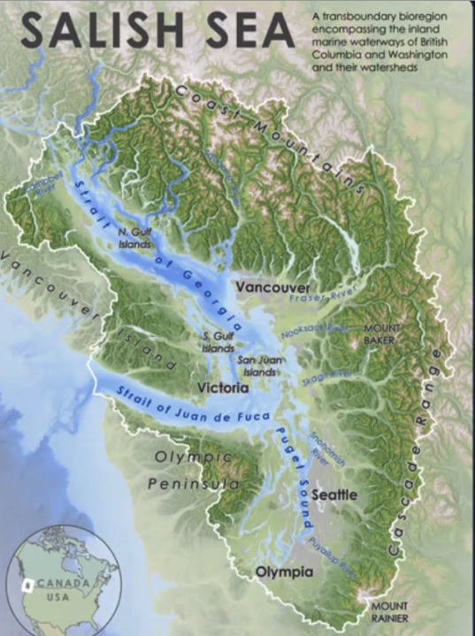
Reference Map for the Salish Sea Bioregion, Salish Sea Atlas Aquila Flower, 2020.
Encompassing:
Straits of Georgia
Puget Sound
Strait of Juan de Fuca
Roberts Bank

Slide 6
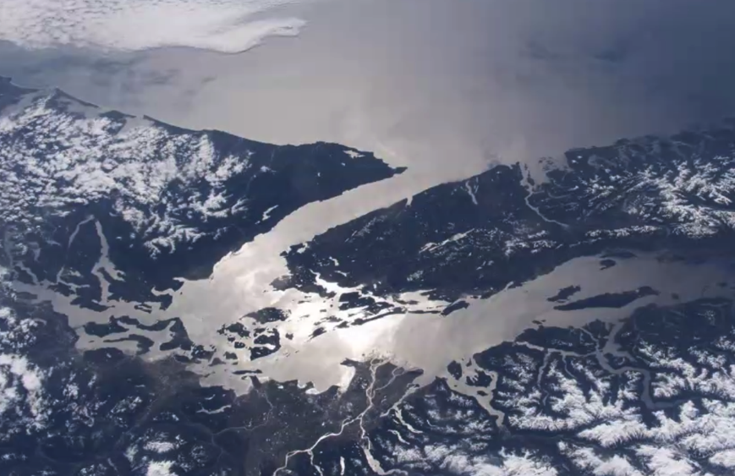
Salish Sea From Space
International Space Station NASA 2020

Slide 7
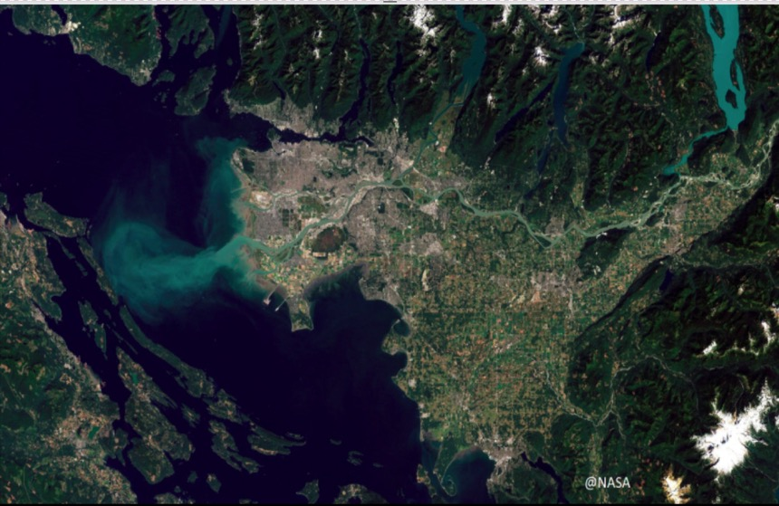
Fraser Estuary
Trans Mountain Pipeline
Inner Harbour Terminal Expansions
Navigation Channel Dredging
Gravel Extraction
YVR Runway Expansion
YVR
Massey Tunnel Replacement
Fraser Surrey Docks Re-configuration
Second Cruise Ship Terminal
Industrial expansion on Agricultural Lands
Sea Level Rise and Climate Change
Airport Jet Fuel Storage
Proposed Roberts Bank Terminal 2
Proposed LNG Export Terminal
Deltaport Berth Four
Ever increasing vessel traffic through an already congested area

Slide 8
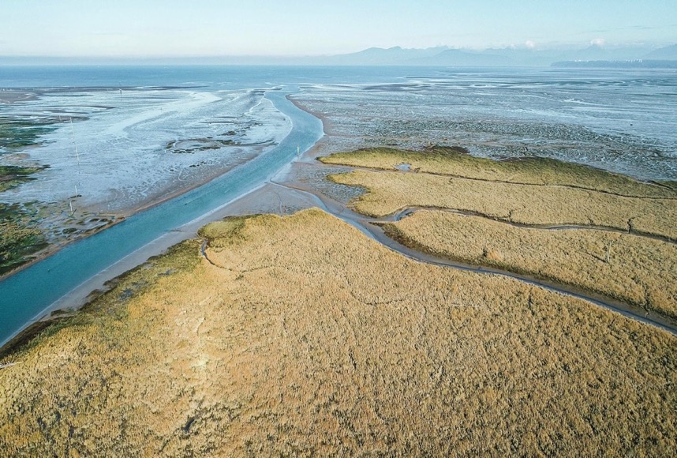
Fraser Estuary Today
Wildlife not as bountiful – populations numbers diminishing, some threatened
Heavily dyked, river and estuary
Canneries, or what is left of them
YVR Airport
Iona and South Arm Jetties
Deltaport and BC Ferry Causeways
Westshore Coal Terminal
Deltaport Container Terminal
Amazon and other warehouses
Shopping Mall
And more
© Yuri Chufour

Slide 9
Despite All That…
Still a key mammal, bird, fish and wildlife habitat:
UN Ramsar Convention designation as a wetland of international importance
Birdlife International – top Important Bird and Biodiversity Area: in danger
Canada – Key Biodiversity Area (In Progress)
Western Hemisphere Shorebird Reserve Network – site of hemispheric importance
BC Wildlife Management Area – “critical wintering grounds for the highest number of waterfowl and shorebirds found anywhere in Canada”.

Slide 10
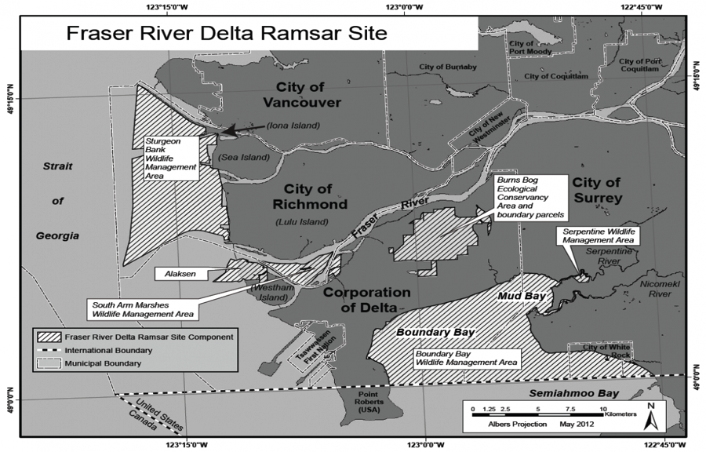
UN Wetland of International Importance (Ramsar Site) 2012

Slide 11
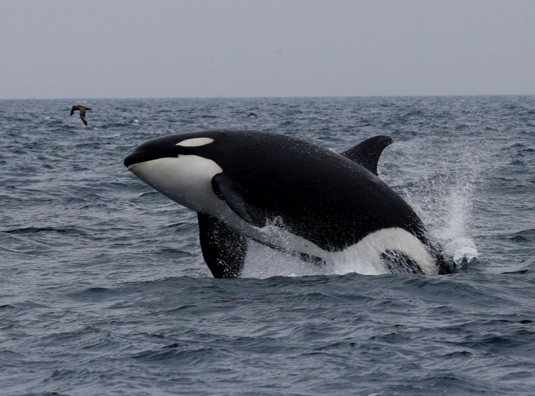
The Ecology

Slide 12
Wildlife
Birds
Shorebirds: Sandpipers, Dunlin, Yellow Legs, Cormorants
Gulls
Barn and Short Eared Owls
Canada Geese
Snow Geese
Trumpeter Swans
American Pelican
Ducks
Peregrine Falcon
Great Blue Heron
Bald Eagle
Red-tailed Hawk
Northern Harrier
Other Birds
Fishes
Salmon: 6 salmon species
–most are in trouble
Herring
Eulachon
Sturgeon
Other Fishes
Marine Mammals
Southern Resident Killer Whales. Three pods: J K and L
Transients
Seals
Crustaceans and Molluscs
Dungeness Crabs
Clams
Others

Slide 13
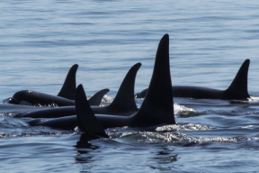
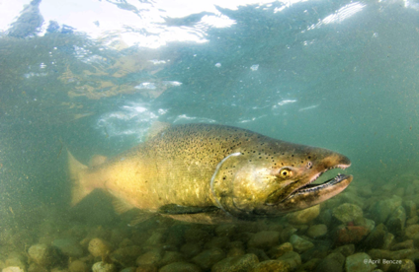
Southern Resident Killer Whales
Each Southern Resident Killer Whale needs up to 20 Chinook Salmon every day

Slide 14
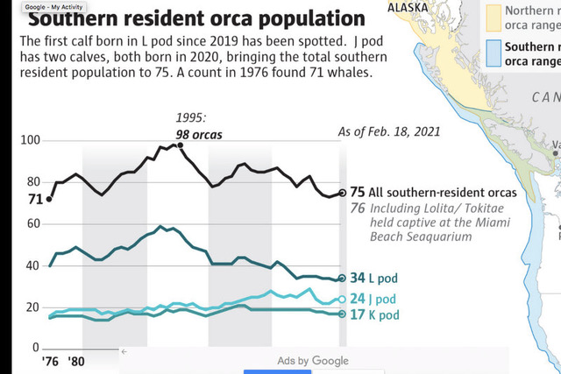
March 2022 Calf born to J pod, first since 2020

Slide 15
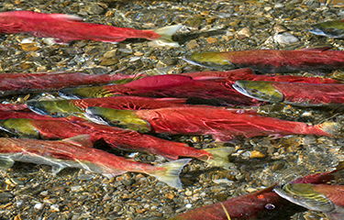
6 Species of Salmon - Most Fraser Populations are in Trouble
Spawning /rearing grounds degraded
Increased predation
Less food
Lack of estuary habitat to transition from river to ocean

Slide 16
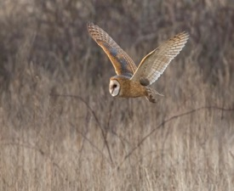
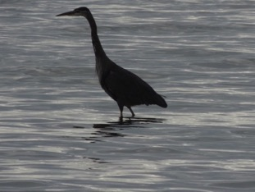
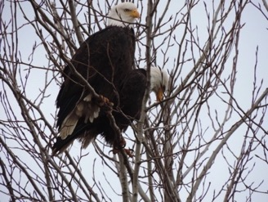
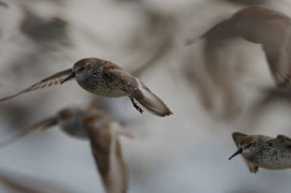
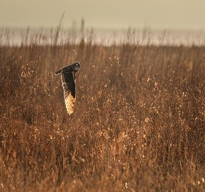
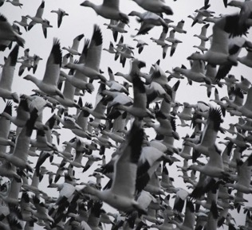
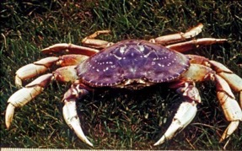
Wildlife on Roberts Bank
Bald Eagle
Barn Owl listed as threatened
Great Blue Heron listed as vulnerable
© Connor Stefanison
© Roger Emsley
© Roger Emsley
© Roger Emsle
Western Sandpiper
Short Eared Owl listed as species of concern
© Jason Puddifoot
Dungeness Crab
Snow Geese
© Yuri Chufour
© David Bradley

Slide 17
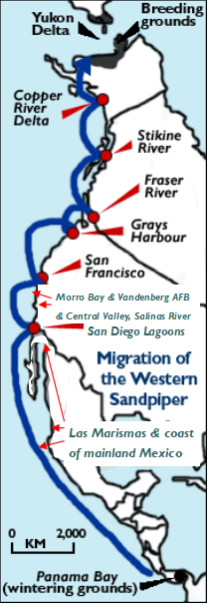
The Pacific Flyway - major estuaries where the birds stop to refuel
UN’s Ramsar Convention – Roberts Bank (RB) designated as a Wetland of International Importance
Birdlife International – RB identified as an IBA under threat that supports more than 50 shorebird species, some of which are globally significant species, several of which are endangered
Environment Canada has said
further port development on RB risks breaking the chain of the Pacific Flyway
RB- Critical stop on Pacific Flyway for millions of migratory shorebirds – Western Sandpipers in particular.
BC Wildlife Management Area – recognized as most important in Canada for biodiversity and shorebirds.
Site of Hemispheric Importance (WHSRN)
Roberts Bank

Slide 18
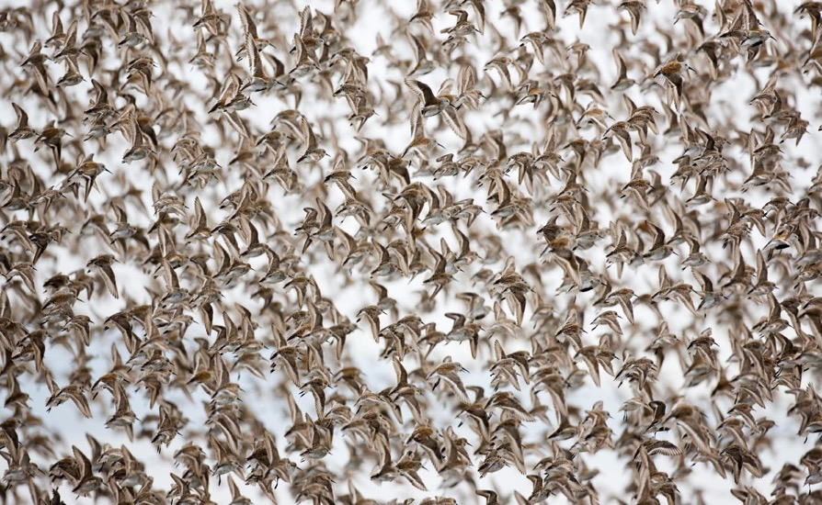
Over 500,000 Western Sandpipers use the Roberts Bank mudflat on a single day in spring migration
© Jason Puddifoot

Slide 19
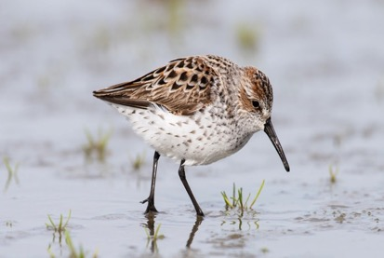
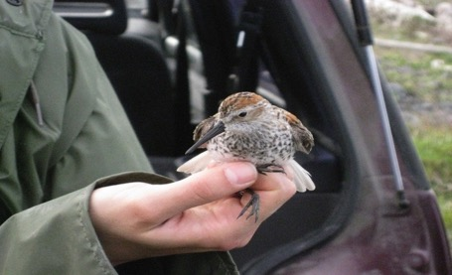
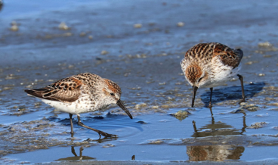
Western Sandpiper have specialized tongues, used to probe the mud and suck up biofilm
© Roger Emsley

Slide 20
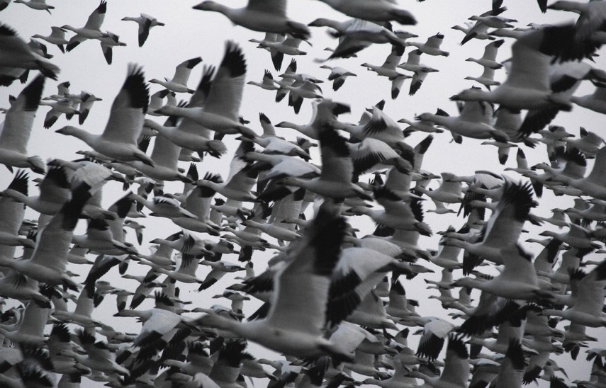
Snow Geese - 150,000 or more winter here. Significant Portion of Wrangal Island Population
© David Bradley
Notes:
These geese are another user of upland habitats
A significant proportion of the Wrangel Island Snow Goose population uses the banks
Up to 38,400 regularly winter here; high numbers also occur on passage in fall and spring.
Counts of 60,000 for the entire Fraser-Skagit Delta population are not uncommon between late October and March
About 100,000 birds were counted in 2007’

Slide 21
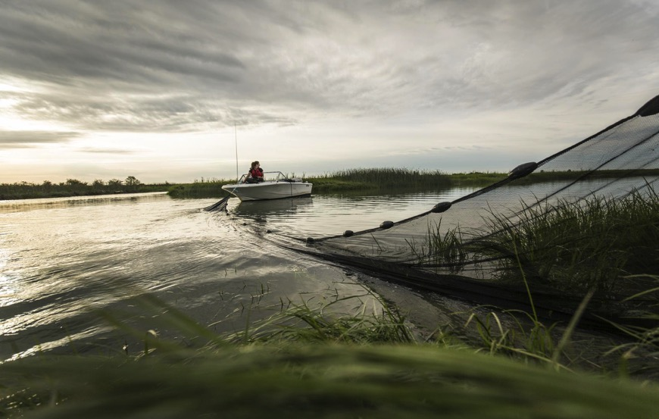
The Environment
Roberts Bank:
- Marsh Grasses
- Mud Flats
- Sand Flats
- Eel Grasses
©Michael Snyder
©Michael Snyder

Slide 22
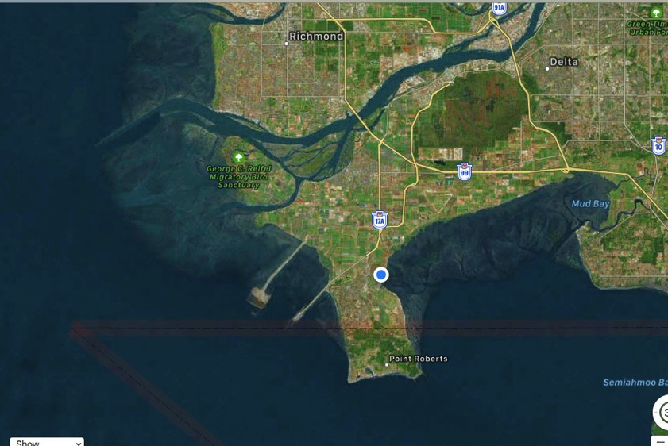
Why is Roberts Bank So Rich in Wildlife?
Fraser River Fresh Water Outflow Interacts with the Tides that Creates Rich Biofilm
Biofilm

Slide 23
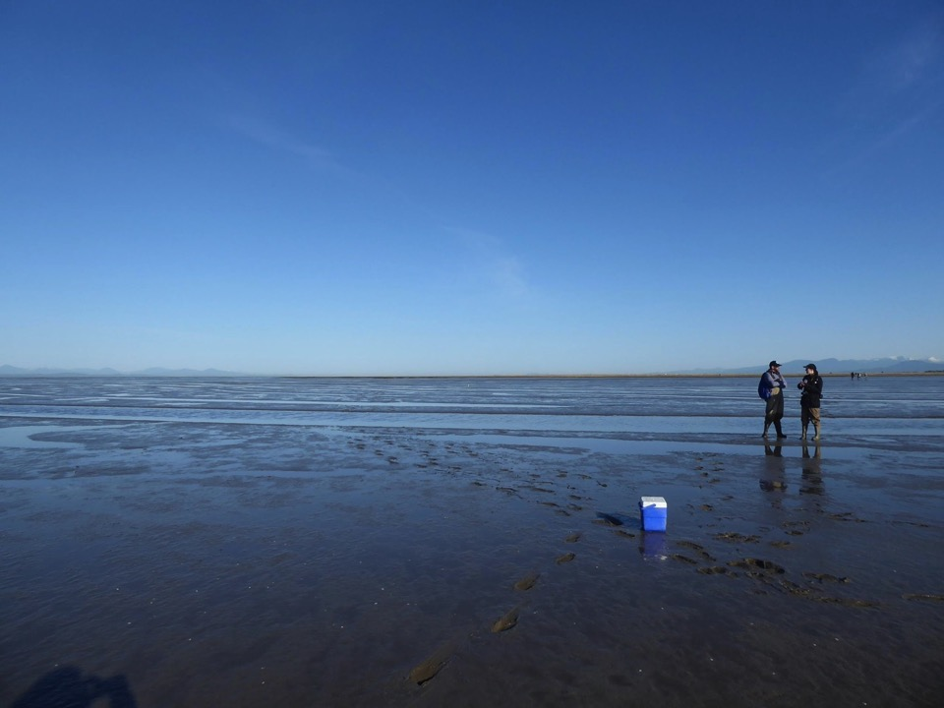
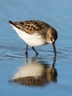
Marine (Saltwater) Biofilm
Biofilm is a community of diatoms, bacteria and tiny invertebrates living in a thin mucus coating on the surface of mud in intertidal waters - a veritable biological powerhouse:
Prime source of polyunsaturated fatty acids, including omega-3's, which cannot be produced by fish or birds themselves, as well as other nutrients
Fatty acids for shorebirds to complete long-distance migration by improving muscle performance etc.
Important food for migratory birds, salmon, fishes, etc.
Lower levels of the food chain consume biofilm directly – such as crabs, mud shrimp, clams, snails.
When fishes, birds, etc. consume these prey they are also consuming fatty acids.
When orcas feed on salmon, or birds of prey feed on other birds and fishes, they also consume fatty acids.
© James Casey
Biofilm becomes most critical in April/May as a result of salinity oscillations, due to the pre-freshet interacting with the tide, shocking the diatoms into a super fatty acid production phase - during spring (breeding) migration of shorebirds

Slide 24

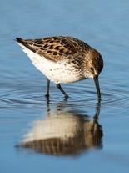
Roberts Bank Mud Flats
Mud flat Slime – thin mucus coating of diatom-rich biofilm on the surface
A major refueling stop for the western sandpiper and other shorebirds, where they stop to refuel for the next leg of their journey
RBT2 dampens salinity oscillations over the entirety of Roberts Bank in April/May the effects of which scientists have portrayed as irreversible, unmitigable and immediate with no means to rectify the damage once RBT2 is approved.
Sandpipers probe the mud and suck up the nutrient rich biofilm – 60% + of their diet
© James Casey

Slide 25
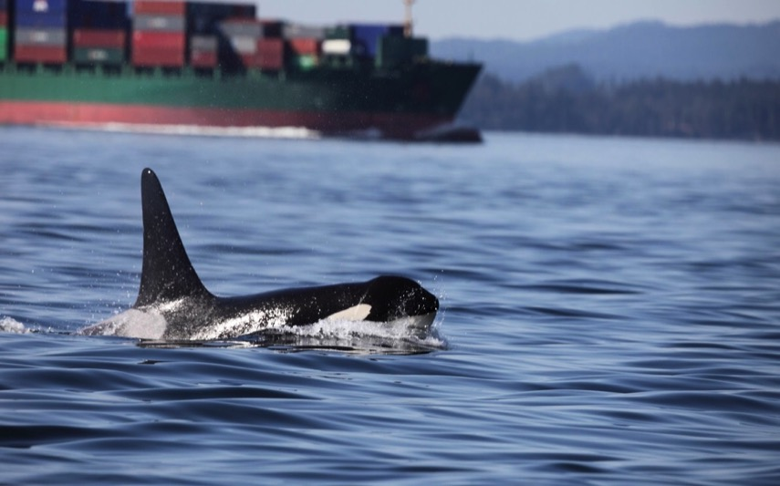
Threats
© Tom Middleton
Port and Industrial Expansion
Ever Increasing Vessel Traffic
Urban Development
© Tom Middleton

Slide 26
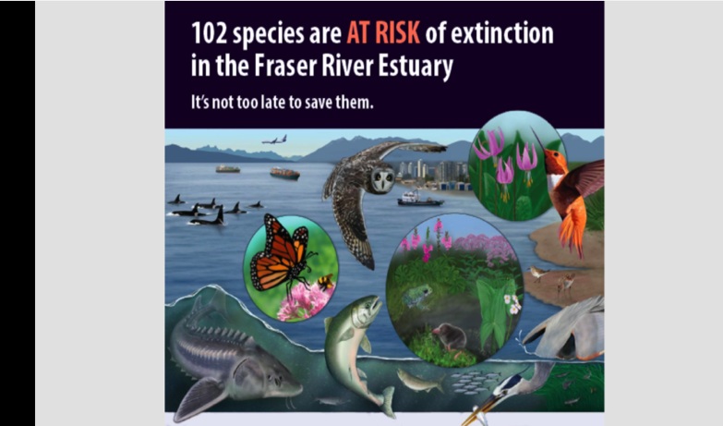
UBC Study Dr. Tara Martin

Slide 27
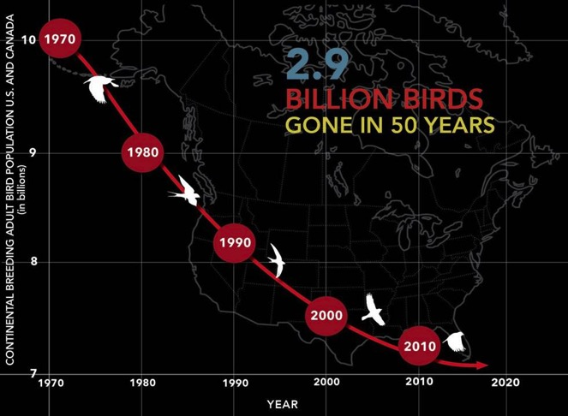
https://www.3billionbirds.org/
Western Sandpipers:
“The overall trend from 1991 to 2017 indicates a decline of -2%/year (P = 0.09).” Canadian Wildlife Service.
As a group shorebirds in Canada have declined by 40% since 1970
#BringBirdsBack
“ IF YOU TAKE CARE OF BIRDS, YOU TAKE CARE OF MOST OF THE ENVIRONMENTAL PROBLEMS IN THE WORLD.” Thomas Lovejoy The Godfather of Biodiversity – Senior Fellow UN Foundation

Slide 28
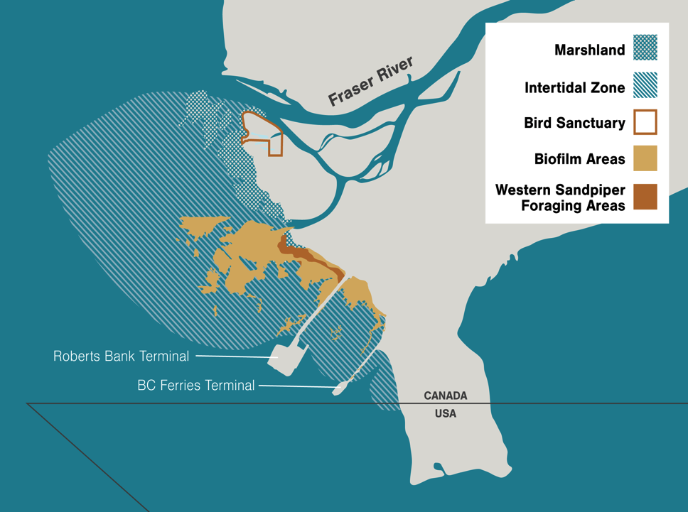
Relied on by millions of shorebirds, herons, orcas, seals, salmon, herring, crabs, and other fishes.
Up to 20 million salmon pass through.
Largest gathering of over wintering raptors.
Terminal 2
Risks breaking the chain of the pacific flyway
Destroys critical mudflats
Puts the Western Sandpiper on the path towards extinction

Slide 29
T2 Dams the Estuary for Juvenile Salmon and alters Tidal Flows, and Salinity thus degrading the Biofilm
Biofilm
Largest Known Area of Eelgrass in BC
Increased Risk of Predation
Dr. Marvin Rosenau
BCIT

Slide 30
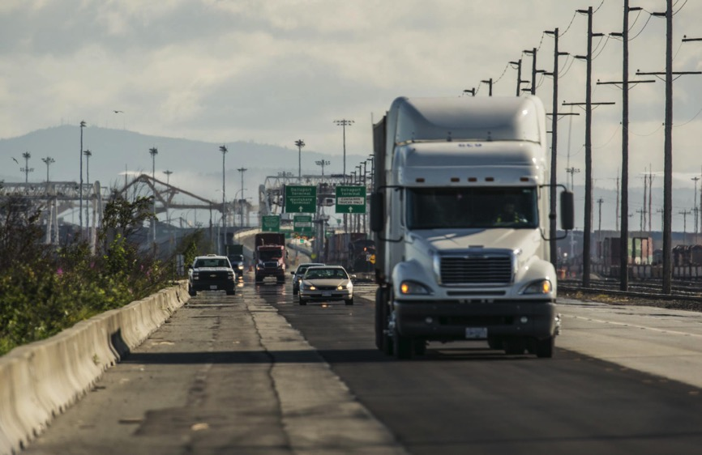
Air, Noise and Light Pollution, Traffic Congestion on Highways
3,000 truck trips per day now. Over 7,000 with Terminal 2 Collisions with vehicles kills Barn Owls
Powerlines kill birds
17 Trains per day now. 29 trains per day with Terminal 2
©Michael Snyder

Slide 31
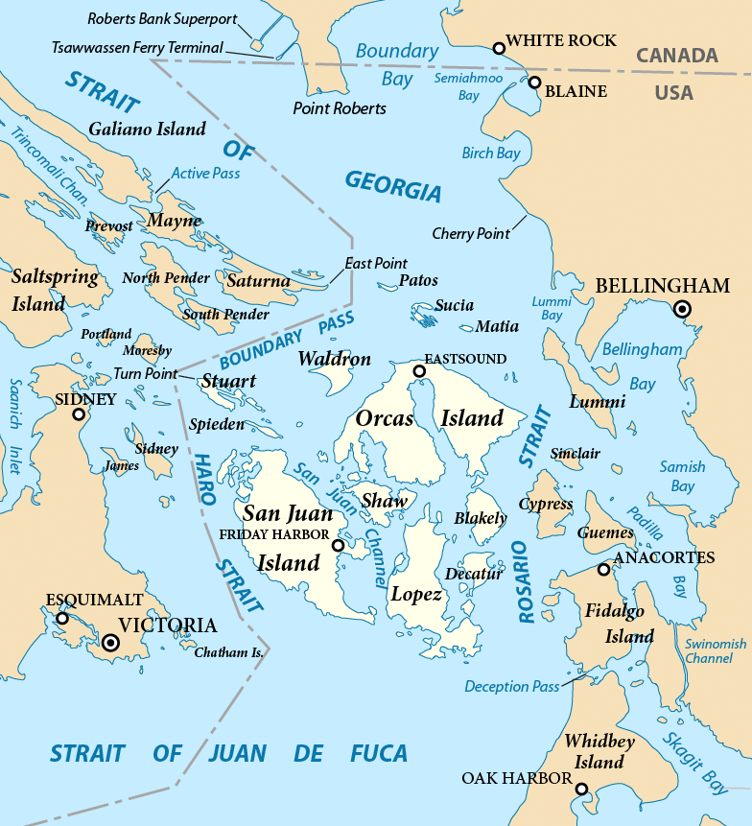
Shipping Lanes
Already too many vessel transits through Haro Strait, prime habitat for Orcas
By Pfly - Own work, CC BY-SA 3.0, https://commons.wikimedia.org/w/index.php?curid=15730665

Slide 32
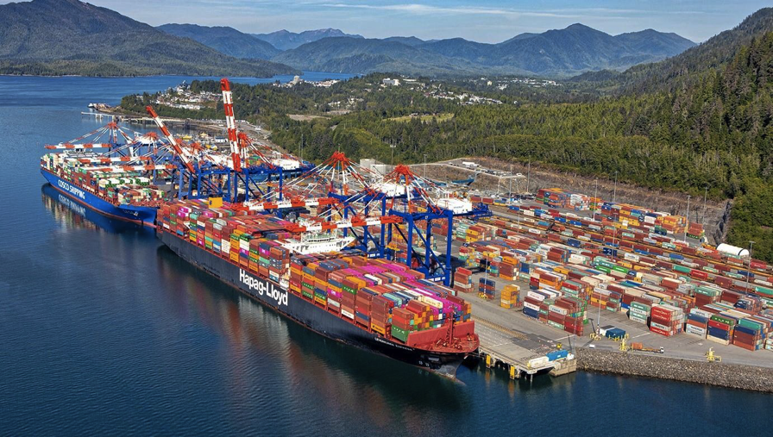
Prince Rupert - the Cheaper, Environmentally Superior Alternative to RBT2
Prince Rupert Terminal Master Plan: “The long-term potential is to develop 6–7 million TEUs of capacity through the development of multiple terminals at the Port of Prince Rupert”.
DP World Logistics Canada

Slide 33
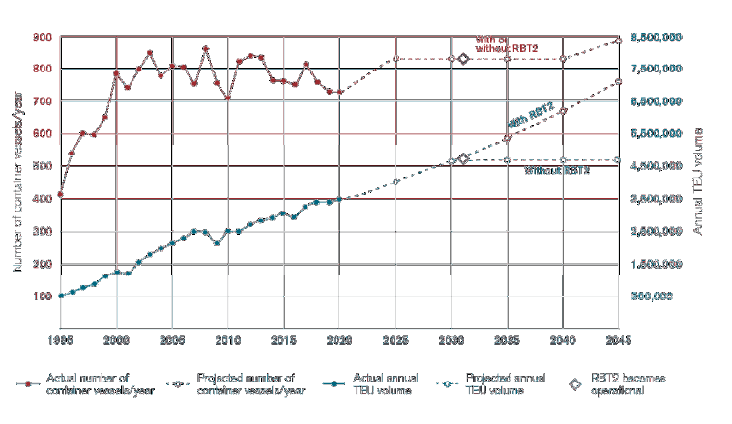
Container Forecasts
Source Port of Vancouver 2021

Slide 34
Container Terminal Capacities
West Coast Canada | 2020 Capacity | 2022 Capacity | 2025 Capacity | 2030 Capacity | 2040 Capacity
Container Capacity to 2040
Container Terminals | TEUs | TEUs | TEUs | TEUs | TEUs
Vancouver
GCT Deltaport | 2,400,000 | 2,400,000 | 2,400,000 | 3,200,000 | 3,200,000
GCT Vanterm | 835,000 | 1,052,000 | 1,052,000 | 1,052,000 | 1,052,000
DPW Centerm | 900,000 | 1,500,000 | 1,500,000 | 1,500,000 | 1,500,000
DPW FSD | 450,000 | 450,000 | 450,000 | 450,000 | 450,000
TOTAL VFPA | 4,585,000 | 5,402,000 | 5,402,000 | 6,202,000 | 6,202,000
Prince Rupert
DPW Fariview* | 1,350,000 | 1,600,000 | 1,800,000 | 1,800,000 | 2,000,000
DPW South Kaien** | - |  |  | 2,500,000 | 3,000,000
TOTAL PRPA | 1,350,000 | 1,600,000 | 1,800,000 | 4,300,000 | 5,000,000
TOTAL | 5,935,000 | 7,002,000 | 7,202,000 | 10,502,000 | 11,202,000
NOTES
* Could handle as much as 2 million TEUs
** Could handle as much as 5 million TEUs

Slide 35
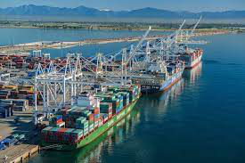
Delta, Richmond and White Rock Councils All Voted to Reject T2

Slide 36
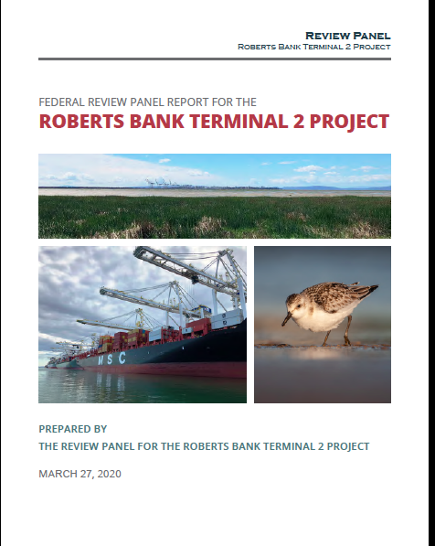
Roberts Bank Terminal 2 Panel Report
“ The Panel concludes that the Project would result in numerous adverse residual and cumulative effects. The proposed offsetting plan for aquatic species, totaling 29 hectares, would be insufficient to compensate for the reduction in productivity associated with a Project-induced habitat loss of 177 hectares of Roberts Bank. There would be significant adverse and cumulative effects on wetlands and wetland functions at Roberts Bank”.
Too Much Risk

Slide 37
Significant adverse and cumulative effects:
Fraser Estuary – 0ver 70% natural habitat already lost
Barn Owls
Seasonal resident shorebirds, migratory birds
Wetlands and wetland functions
Ocean type juvenile Chinook salmon originating from the Lower Fraser and South Thomson Rivers disrupting their migration from river to ocean
Dungeness crabs and Commercial crab fishery
Degradation of SRKW habitat, losing part of their critical habitat, reduced prey availability, increase in underwater noise
Current use of lands and resources for traditional purposes by First Nations
Agricultural land use due to the lack of Industrial land
Quality of life of local populations, including health and quality of experience during commercial and recreational activities, as well as daytime and night-time visual resources and on outdoor recreation.
Human health based on predicted exposures to 1-hour average NO2 and other respiratory irritants, as well as noise stress and annoyance related to light, noise and increased levels of dust.

Slide 38
Roberts Bank Terminal 2 Final Public Comment Period - Decision Time
Hundreds of Opposing Submissions
Very Few Supporting Submissions
Opponents include scientists and biologists expert in coastal ecology and wetlands, national and international environmental groups, Birds Canada, Nature Canada, Birdlife International, citizen scientists, Indigenous Groups – Canada and US
Federal Government – approves with mitigation, or approves as justified in the circumstances, or denies approval

Slide 39
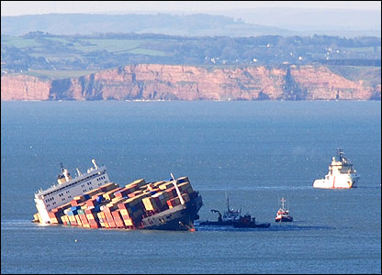
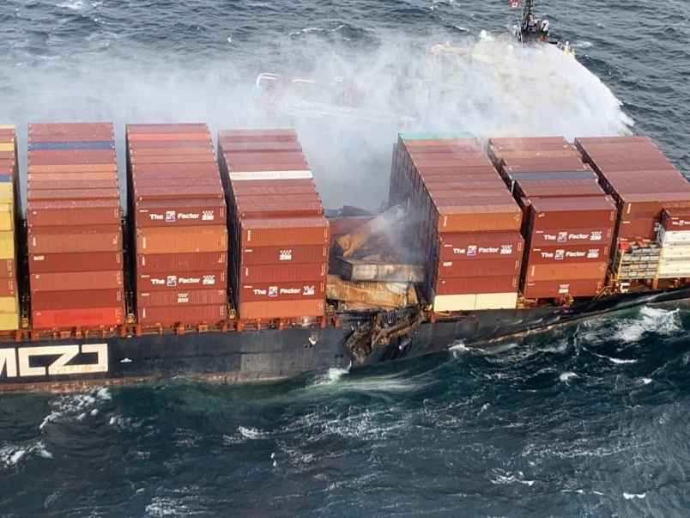
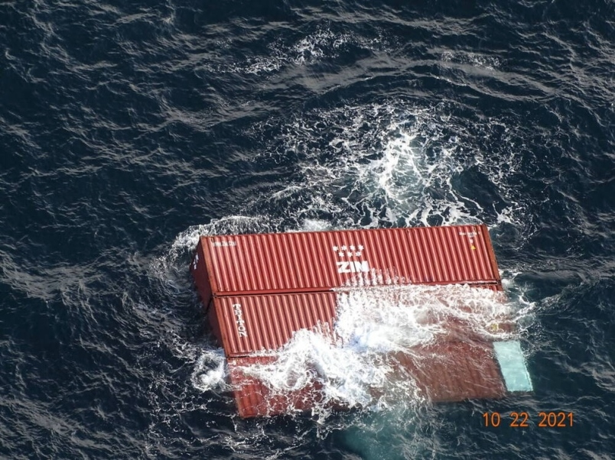
Can we Risk this Happening In the Salish Sea or Juan de Fuca Strait?
It already did!!!
MV Kingston Lost 109 containers overboard and caught fire in Juan de Fuca Strait October 2021
English Channel

Slide 40

Issues Impacting the Fraser Estuary
Trans Mountain Pipeline
Inner Harbour Terminal Expansions
Navigation Channel Dredging
Gravel Extraction
YVR Runway Expansion
YVR
Massey Tunnel Replacement
Second Cruise Ship Terminal
Fraser Surrey Docks Re-configuration
Industrial expansion on Agricultural Lands
Sea Level Rise and Climate Change
Airport Jet Fuel Storage
Proposed Roberts Bank Terminal 2
Proposed LNG Export Terminal
Deltaport Berth Four
Ever increasing vessel traffic through an already congested area

Slide 41
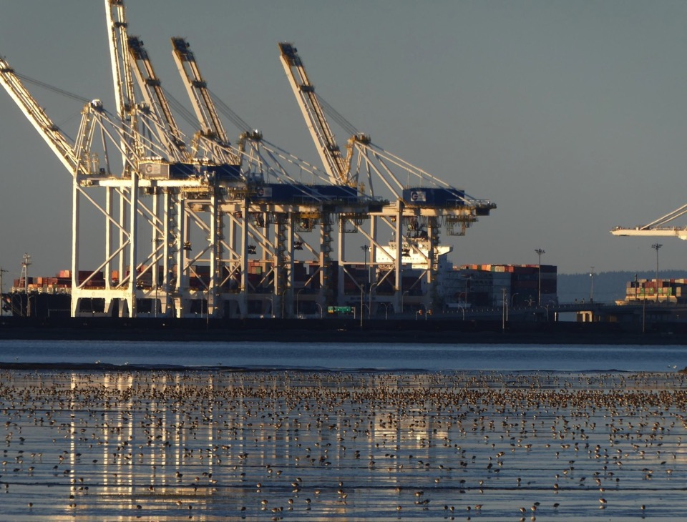
What Can You Do ?
© James Casey
1. Significasnt adverse environmental effects that cannot be mitigated
2. No business need tor T2. There is a better alternative. Prince Rupert has potential to quadruple its current container terminal capacity.
- Two sailing days closer to Asia
- No significant environmental issues
Make your Voice Count. Tell Government
to Reject Roberts Bank Terminal 2:
- Write to the Environment Minister: ec.ministre-minister.ec@canada.ca
- Write to MP Carla Qualtrough: carla.qualtrough@parl.gc.ca
- Write Letters to the Media
- Post on Facebook, Twitter, Linked In

Slide 42
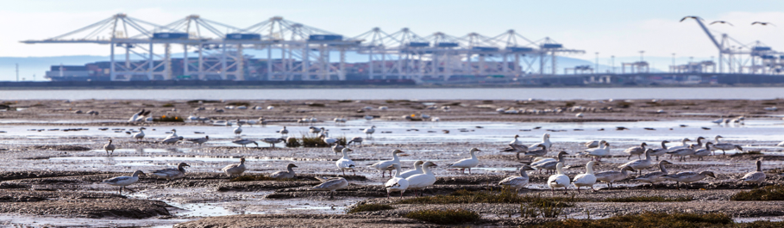
Contact Roger Emsley Against Port Expansion Community Group For More Information: info@againstportexpansion.org
Websites:
https://www.againstportexpansion.org
https://www.birdscanada.org/?s=roberts+bank
Further Reading::
https://www.hakaimagazine.com/features/slime-shorebirds-and-scientific
https://www.hakaimagazine.com/features/questionable-science-vancouvers-port-expansion/
© James Casey

Slide 43
Actions needed to Save the Estuary
Make Roberts Bank a National Marine Conservation Area.
Expand the Fraser River Delta designation as a UN “Wetland of International Importance”
(Ramsar Site) to encompass all of Roberts Bank.
Provide immediate protection to biofilm habitat at Roberts Bank by designating it a Provincial Ecological Reserve.
Place a cap on the number of vessel transits through the Strait of Juan de Fuca and Salish Sea.
No more port development on Roberts Bank.
Diversify trade expansion by maximizing the potential of the port facilities at Prince Rupert.

Slide 44
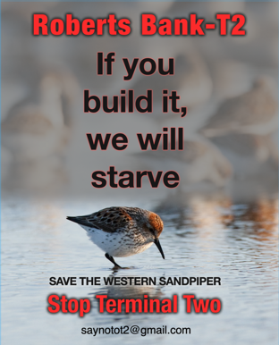
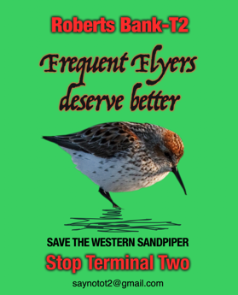
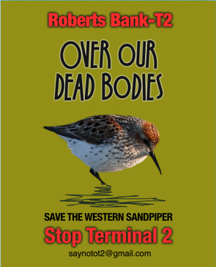
Questions

